Slide 1
LINEAR ALGEBRA
Tim Dosen Pengampu
TM09

Slide 2
Outline
[1] Vector Space and Sub Space
[2] Null Spaces, Column Spaces, and Linear Transformations
[3] Linearly Independent Sets; Bases
[4] Coordinate Systems
[5] The Dimension of A Vector Space

Slide 3
Vector Spaces

Slide 4
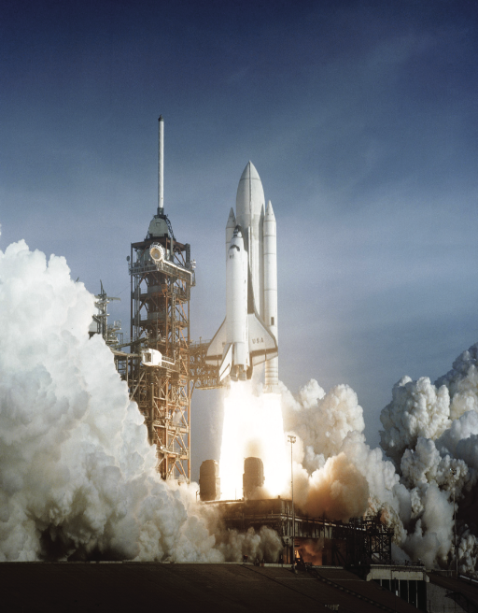
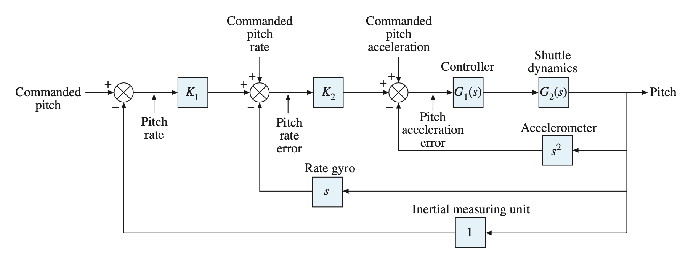
Space Flight and Control System

Slide 5
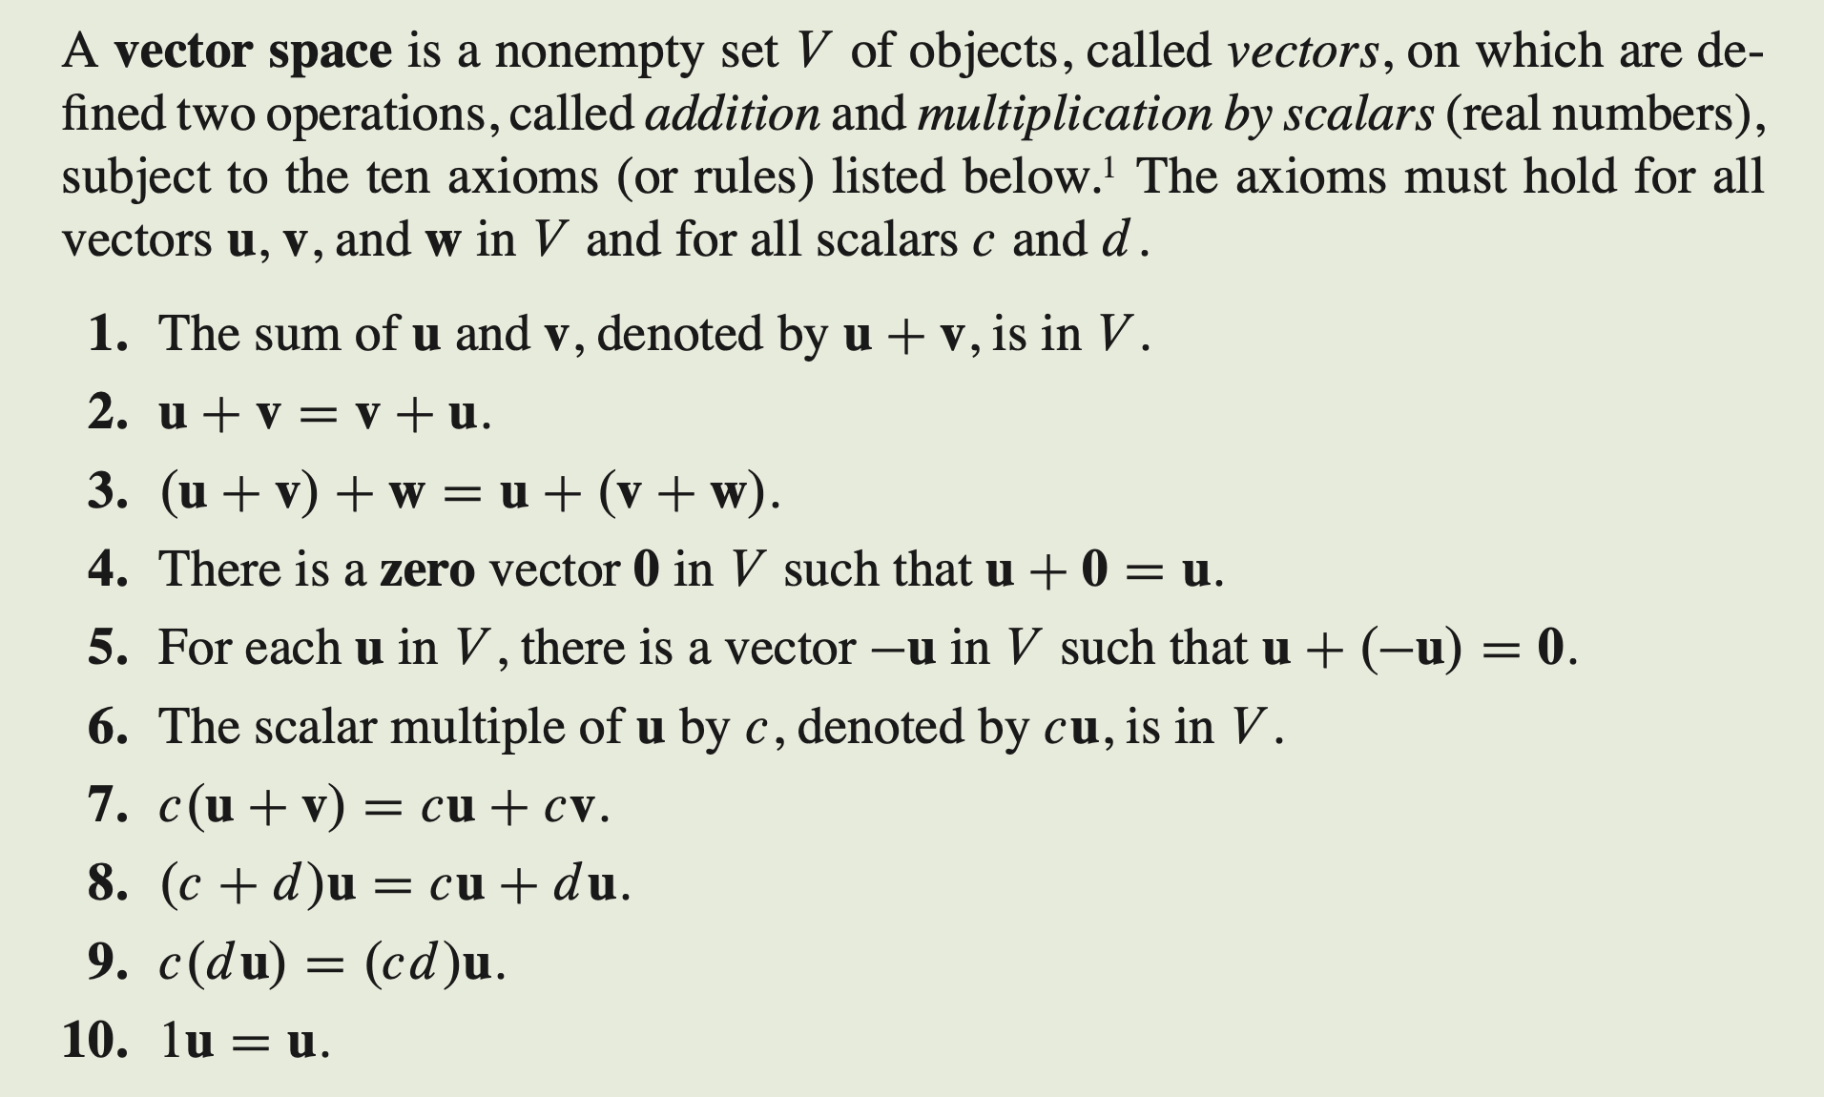
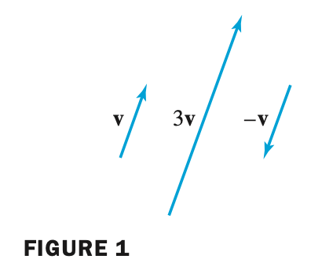
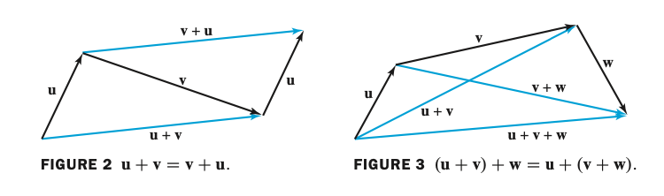
Vector Space

Slide 6
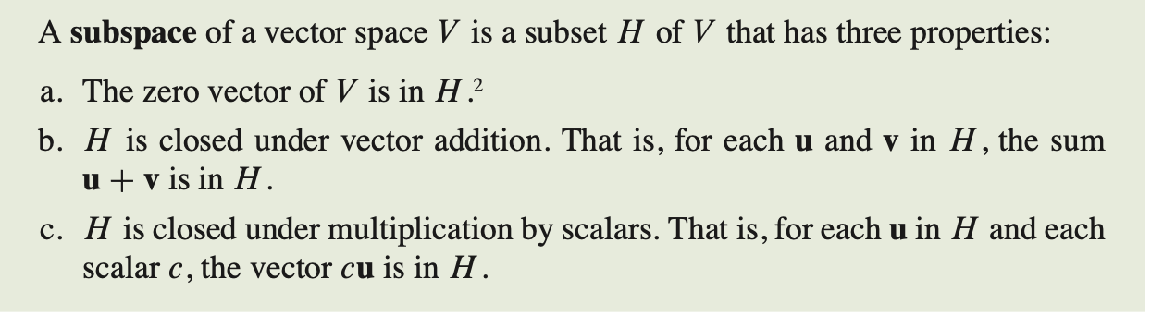
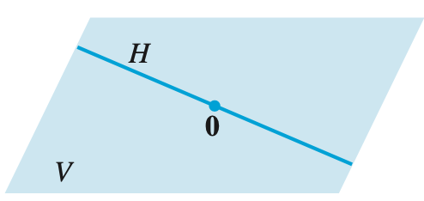
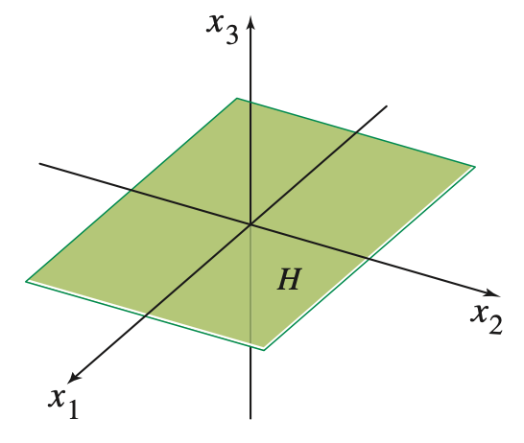
Subspaces
Subspace of V
x₁, x₂-plane as a subspace

Slide 7
NULL SPACES, COLUMN SPACES, AND LINEAR TRANSFORMATIONS

Slide 8
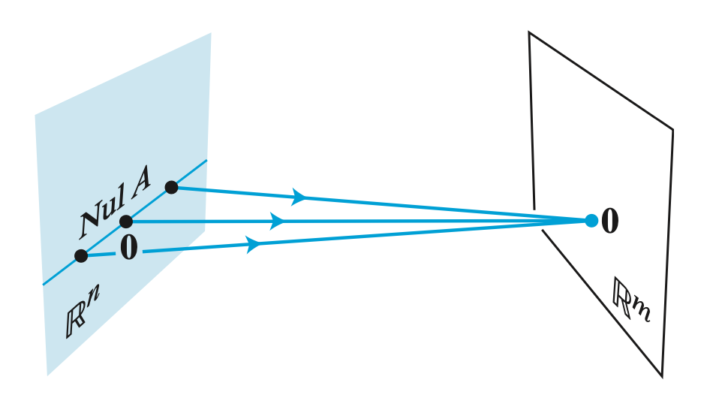
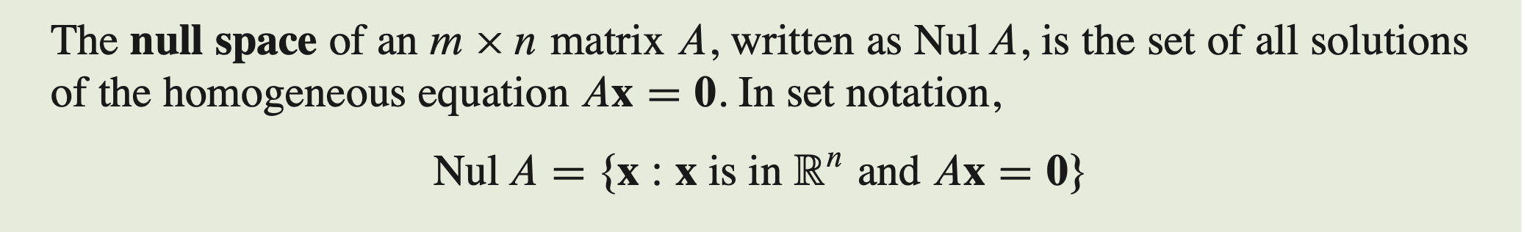
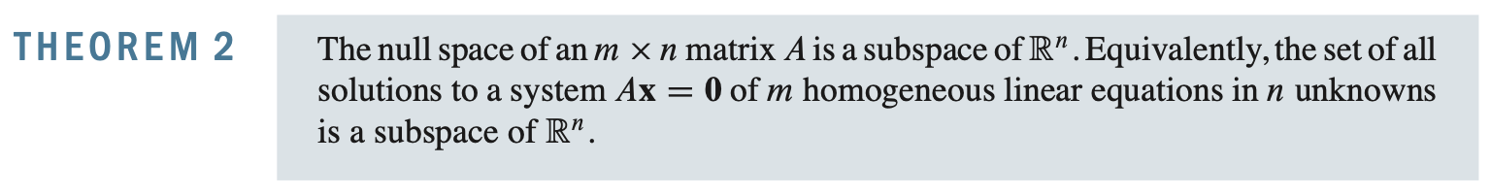
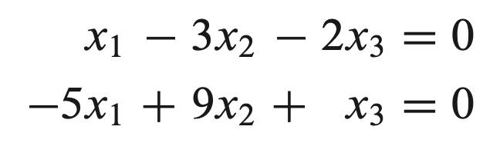
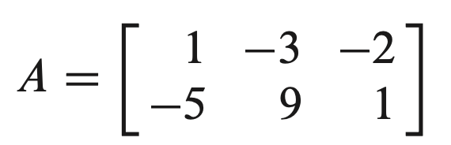
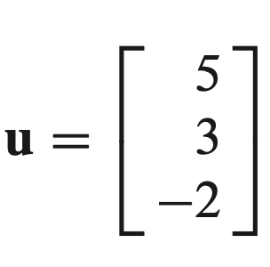
Null Spaces
Contoh:
Tentukan, apakah
adalah Null Space dari A

Slide 9
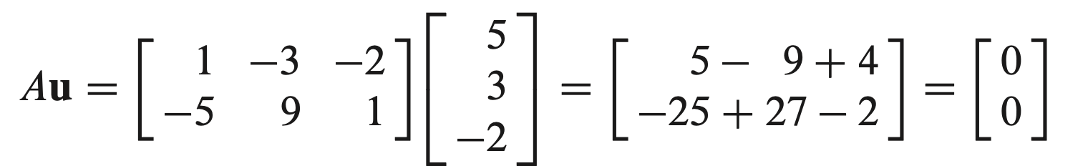
Null Spaces
Jawaban: IYA

Slide 10
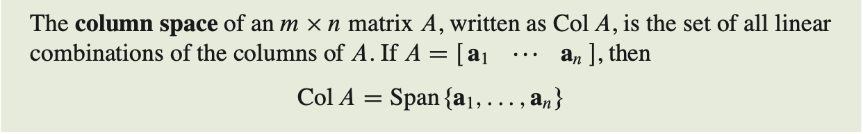
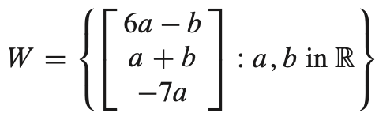
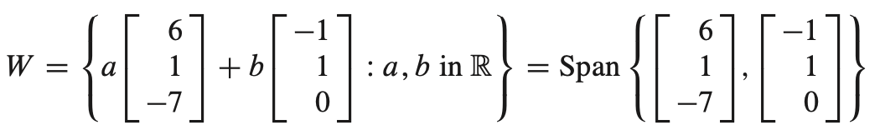
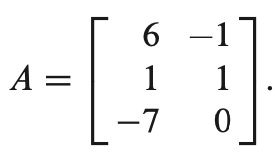
Column Space
Contoh:
Tentukan matrik A sedemikian hingga W = Col A.

Slide 11
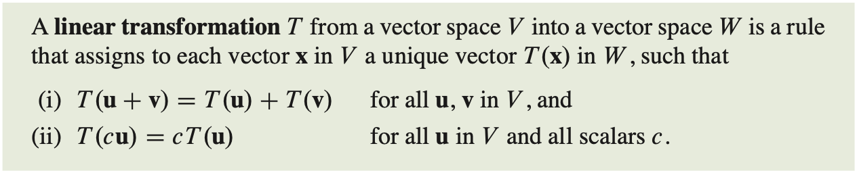
Linear Transformation

Slide 12

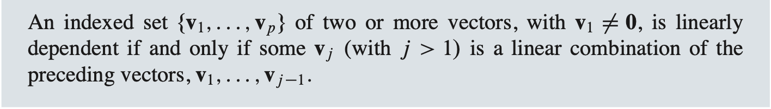
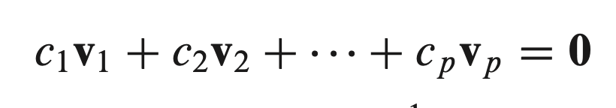

LINEARLY INDEPENDENT SETS; BASES
Linearly Independent:
has only the trivial solution,

Slide 13
Example 1
Show that the set {(1, 2, 3), (−2, 1, 1), (8, 6, 10)} is linearly dependent in R³.
Solution
Suppose
⇒
c₁ = 4 c₂ = −2 c₃ = −1
Thus The set of vectors is linearly dependent.

Slide 14
Example 2
Show that the set {(3, −2, 2), (3, −1, 4), (1, 0, 5)} is linearly independent in R³.
Solution
Suppose
⇒
⇒
This system has the unique solution c₁ = 0, c₂ = 0, and c₃ = 0. Thus the set is linearly independent.

Slide 15
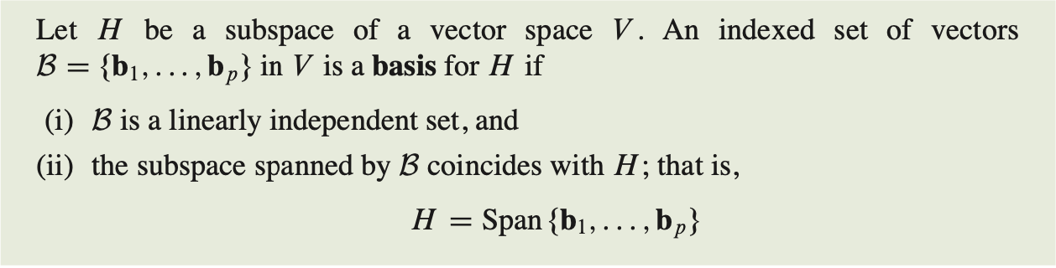
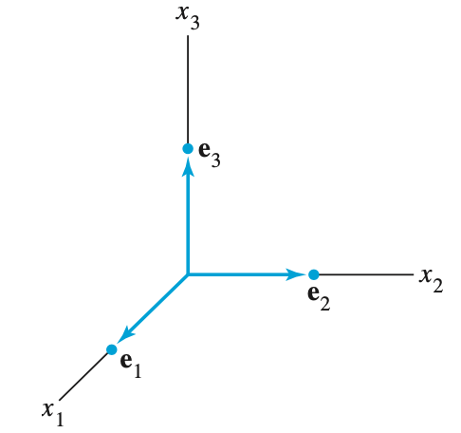

LINEARLY INDEPENDENT SETS; BASES
=
{e1, e2, e3} standard basis for $ℝ$³

Slide 16
Example
Show that the set {(1, 0, −1), (1, 1, 1), (1, 2, 4)} is a basis for R³.
Solution
(span)
Let (x₁, x₂, x₃) be an arbitrary element of R³. Suppose
⇒
⇒
Thus the set spans the space.

Slide 17
(linearly independent) Consider the identity
The identity leads to the system of equations
⇒ b₁ = 0, b₂ = 0, and b₃ = 0 is the unique solution. Thus the set is linearly independent.
⇒ {(1, 0, −1), (1, 1, 1), (1, 2, 4)} spans R³ and is linearly independent. ⇒ It forms a basis for R³.

Slide 18
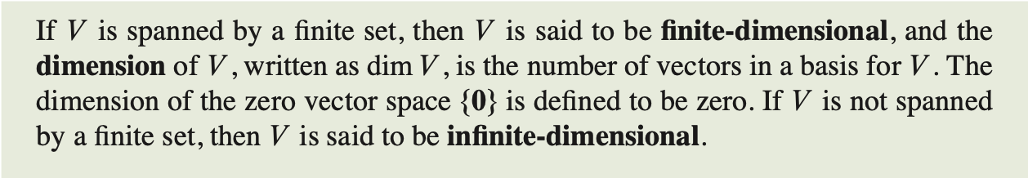
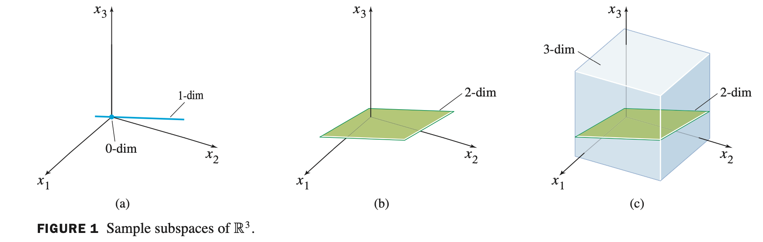
The Dimension of Vector Space
=

Slide 19
Example
Consider the set {{1, 2, 3), (-2, 4, 1)} of vectors in R³. These vectors generate a subspace V of R³ consisting of all vectors of the form
The vectors (1, 2, 3) and (-2, 4, 1) span this subspace.
Furthermore, since the second vector is not a scalar multiple of the first vector, the vectors are linearly independent.
Therefore {{1, 2, 3), (-2, 4, 1)} is a basis for V. Thus dim(V) = 2. We know that V is, in fact, a plane through the origin.

Slide 20
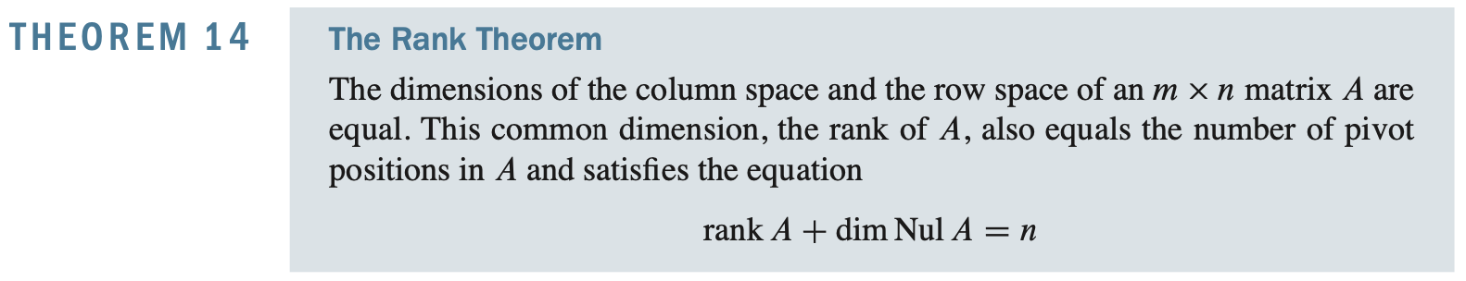
The Rank

Slide 21
Terimakasih

